Slide 1

AIRBNB Data Analysis
By: Shraddha Pawar

Slide 2
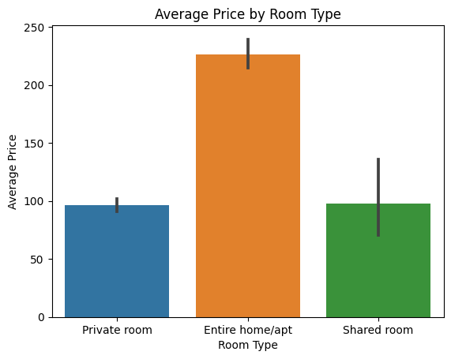
Room Type Analysis
Entire room or apartment listings tend to be the most expensive compared to private room and shared rooms
This suggests that guests are willing to pay a premium for the privacy and exclusivity provided by an entire room or apartment

Slide 3
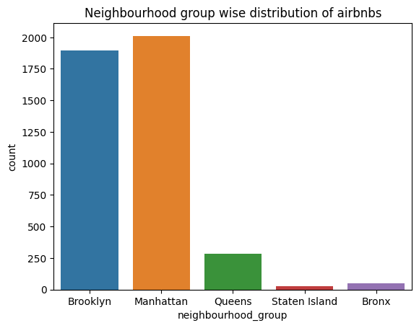
Neighborhood group wise distribution of Airbnb
Manhattan has the highest number of Airbnb listings compared to other neighborhoods in New York City
This suggests that Manhattan is a highly desirable location for both hosts and guests

Slide 4
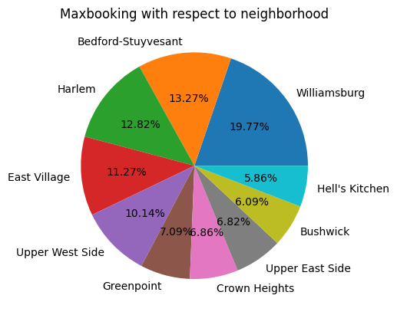
Maximum booking with respect to neighborhood
Williamsburg emerges as the neighborhood with the highest number of room bookings
This indicates that Williamsburg is a popular choice among travelers

Slide 5
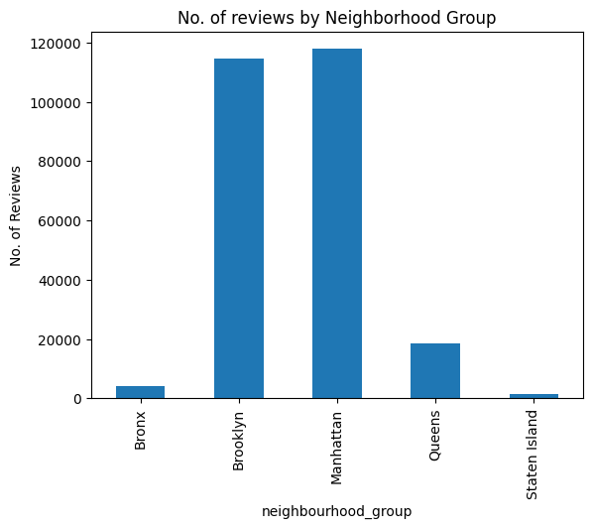
No. of reviews by Neighborhood Group
Manhattan has the highest number of reviews among all neighborhoods
This suggests that Manhattan attracts a significant number of guests who leave reviews

Slide 6

Insights
Entire room or apartment is the most expensive compared to private room and shared rooms.
The majority of people prefer booking entire room or apartment listings.
Manhattan has the maximum number of Airbnb listings in the whole of NYC.
Williamsburg has the maximum number of room bookings.
Manhattan has the maximum number of reviews among all neighborhoods.

Slide 7

Thank you

